Slide 1

ATM MACHINE
Project work done by
LOGESH E 412919104006
NAGARAJ V 412919104008
KISHORE KUMAR P 412919104006
Department of Computer Science & Engineering
Guide Name : Mr. S.Prabu M.E

Slide 2

ATM MACHINE
Design and implement an ATM MACHINE that simulates the functions of a real ATM.
The ATM will support PIN authentication , balance inquiry , and Withdrawal. If time permits , will add deposit and transfers.
Devolop reqirements for an ATM with withdrawal , Deposit and balance inquiry.
Determine what public methods (interface) are needed for an ATM U.I
Determine what services are needed from the bank Subsystem.
For this phase , we will use a dummy bank . It approve all requests.

Slide 3
HARDWARE & SOFTWARE
REQUIREMENTS
SOFTWARE REQUIREMENTS
HARDWARE REQUIREMENTS
Processor : intel Dual based system
Speed : 1GHz to @2GHz
RAM : 256 MB to 512 MB
Hard Disk : 4 GB to 30 GB
Operating system : Windows
Language : Java
Connectivity : JDBC Driver
Front End :- Eclipse IDE for
enterprise java and
web developers.
Back End : Xampp , my sql

Slide 4
ABSTRACT
The ATM system is the project which is used to access their bank accounts in Order to make the cash withdrawals.
Whenever the user needs to make cash withdrawals, they can enter their PIN Number (personal idendification number) and it will display the amount to be Withdrawn in the form of 100’s and 500’s.
Once their withdrawn was successful, the amount will be debited in their account.
The atm will service one customer at a time. A customer will be reuired to enter ATM card number, PIN – both of which will be send to the database
for validation as a part of each transaction.
Also customer must be able to make a balance inquiry of any account linked to the card.

Slide 5
ATM SOFTWARE
Automated teller machine, a machine of a bank branch or other location
Which enables a customer to perform basic banking activities (checkingone’s
balance , withdrawing or transferring funds)even when the
bank is closed.
It enables the customer to perform several banking operations without
The help of a teller , such as to withdraw cash , make deposits , pay Bills ,
obtain bank statements , effect cash transfers.
Also called automated Banking machine , automatic till machine , or remote
Service unit

Slide 6
OBJECTIVES OF PROJECT
OBJECTIVES :
To analyses & discuss the stragic issues present in automated Teller machine .
To make observation about the concepts & functions of automated Teller
Machine.
Understand the nature & structure of automated Teller Machine.
To link theoretical Knowledge with real life.
Our main objectives is to speed up the transactions done by customers.
No manual transactions needed generally. The second objectives is to save the time which is very important now-a-days.
To render accurate services to customers. The reduction of fraudulent activities.
To reduce error processing, the guarantee of increases.

Slide 7
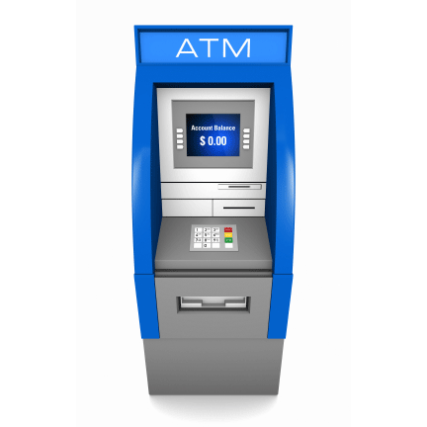
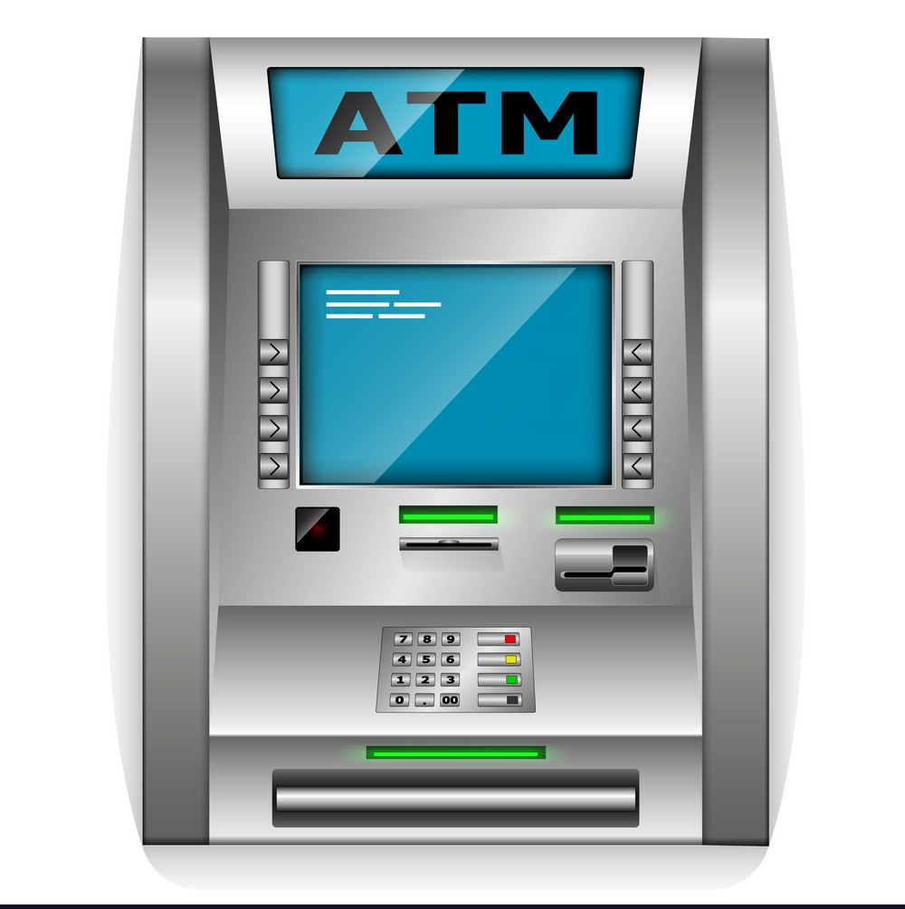
SCOPE OF PROJECT
Provides Customer to :
Financial Flexibility.
World Wide acceptance.
Round the clock convince.
Filling of Bills.
Fund Transfer.
Net Banking Registration.
Use of ATM :
Cash Withdrawal and Balance Enquiry
Bill payments
Cash/Cheque Deposit

Slide 8
Existing sysytem
In the manual system,firstly the bank manager and its staff have to manage information regarding the accounts and transactions of all the customers manually.
Doing this manual transactions was really tedious job. Secondly
Information regarding accounts and transactions of customers were to be maintained.
This process is time consuming and it requires a great manual effort.
Disadvantages :
More time is consumed.
More hardwark to maintain all records.
Bulk of paper is to be searched for a single search

Slide 9
NEW PROPOSED SYSTEM:
This system provides paperless maintenance. Inially a cashier or an clerk
Can be appointed to do all the transaction and update and maintain records.
In the new system the customer himself can do all the transaction and the Computerized system automatically updates and maintain the records.
Advantages :
less effort to complete transaction.
Less time required.
No need to maintain the bulk of papers.

Slide 10

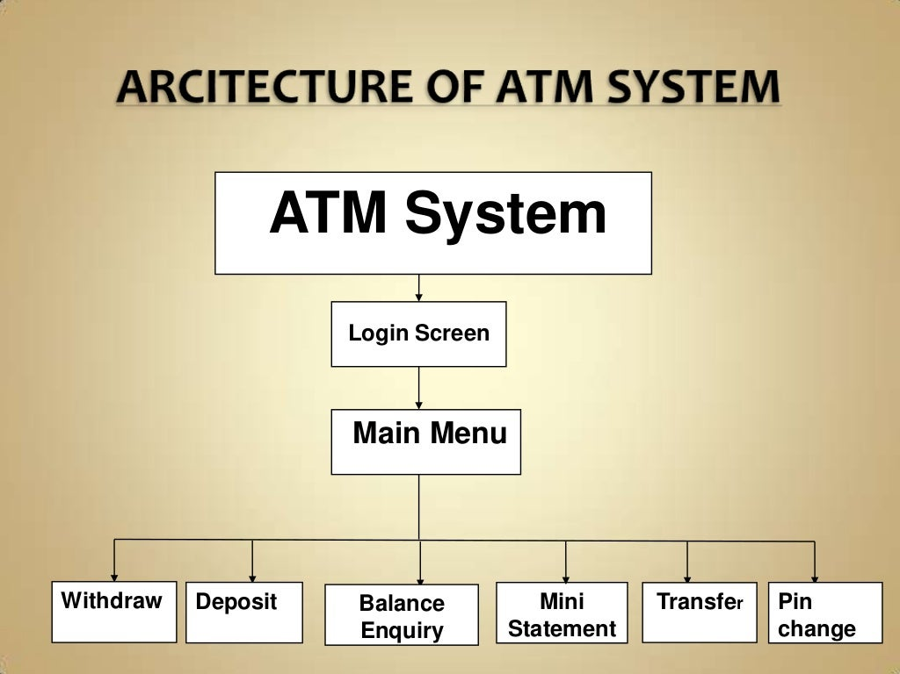

Slide 11
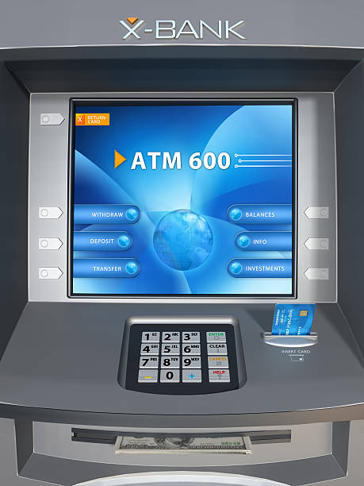
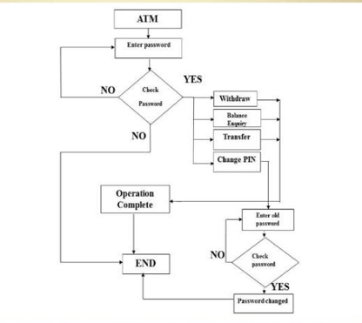
FLOW CHART

Slide 12
REFERENCE
DREAMCODE.NET,2014 .[Online]
Available at : http://www.dreamincode.net
EXAMPLES.JAVACODEGEEKS, 2014 .[Online]
Available at : http://examples.javacodegeeks.com
NETBEANS.ORG, 2016. [Online]
Available at : http://netbeans.org
ORACLE.COM, 2014.dosc.oracle.com. [Online]
Available at : http://docs.oracle.com
PROGRAMCREEK.COM, 2008. [Online]
Available at : http://www.programcreek.com

Slide 13
Conclusion
The projects on “ATM MACHINE” has been developed as the best flexible and efficient project within the available resources and time.
In future we r planning to add new feature like Fingure Print Reader and Eye Detection System for authendication of user Security purpose.
Care has been taken at each step to make it more user friendly so that users can added new features where ever necessary while using this automated system for Authendication of user security purpose.
The ATM’s have gained worldwide popularity within a few years.
The customers using the ATM machine are satisfies with the service and have very complaints about the machines.

Slide 14
Thank You
For Your Attention

